Slide 1
Digital Portfolio
STUDENT NAME: Kavitha N
REGISTER NO AND NMID: 212403904/167C9575D3DA8A68DE147C3F0CFC286F
DEPARTMENT: computer application (BCA)
COLLEGE: Tagore college of arts and science Chromepet Chennai 44 (Madras University )

Slide 2
PROJECT TITLE
Kavitha N PORTFOLIO PROJECT

Slide 3


AGENDA
Problem Statement
Project Overview
End Users
Tools and Technologies
Portfolio design and Layout
Features and Functionality
Results and Screenshots
Conclusion
Github Link
3/21/2024 Annual Review

Slide 4

PROBLEM STATEMENT
Many students and professionals struggle to present their skills, projects, and achievements in an organized and accessible way. A personal portfolio website solves this problem by creating a digital identity that is easy to share and highlights strengths effectively.

Slide 5

PROJECT OVERVIEW
The project is a responsive personal portfolio website designed to display personal details, skills, projects, certifications, and contact information. It acts as an online resume to enhance career opportunities.
---

Slide 6

WHO ARE THE END USERS?
Students who want to showcase their projects.
Job seekers looking to impress recruiters.
Professionals wishing to highlight their work.
Recruiters who want a quick overview of candidates’ skills.

Slide 7
TOOLS AND TECHNIQUES
HTML5 – structure
CSS3 – styling
JavaScript – interactivity
GitHub Pages – hosting

Slide 8
POTFOLIO DESIGN AND LAYOUT
Homepage with introduction.
About Section with personal details.
Skills Section showcasing technical skills.
Projects Section with descriptions and links.
Contact Section with details and links.
‹#›

Slide 9
FEATURES AND FUNCTIONALITY
Homepage with introduction.
About Section with personal details.
Skills Section showcasing technical skills.
Projects Section with descriptions and links.
Contact Section with details and links.

Slide 10
RESULTS AND SCREENSHOTS
Successfully deployed live portfolio website.
Displays all personal and professional details in a clean format.
Accessible through Portfolio Link.
3/21/2024 Annual Review
‹#›

Slide 11
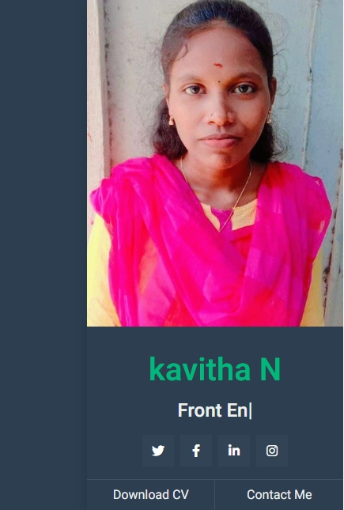
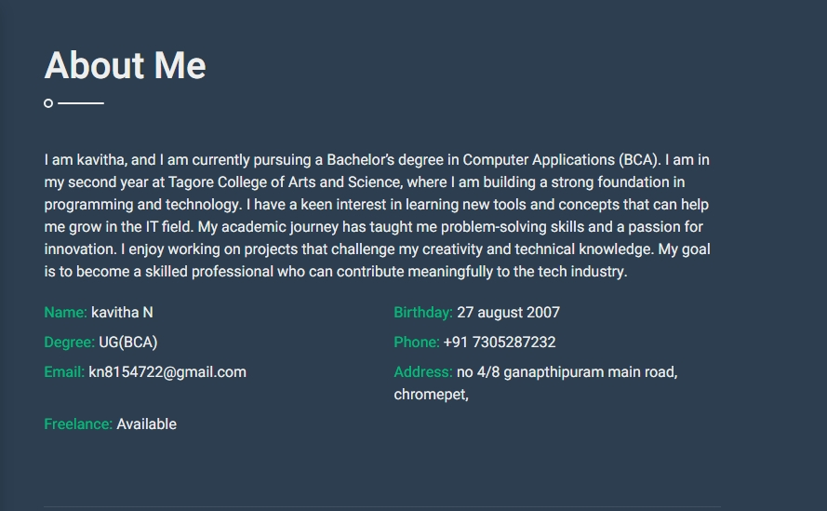

Slide 12
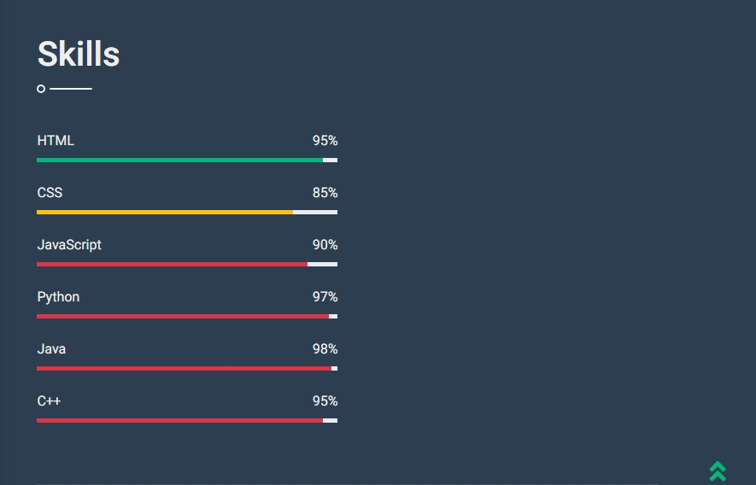

Slide 13
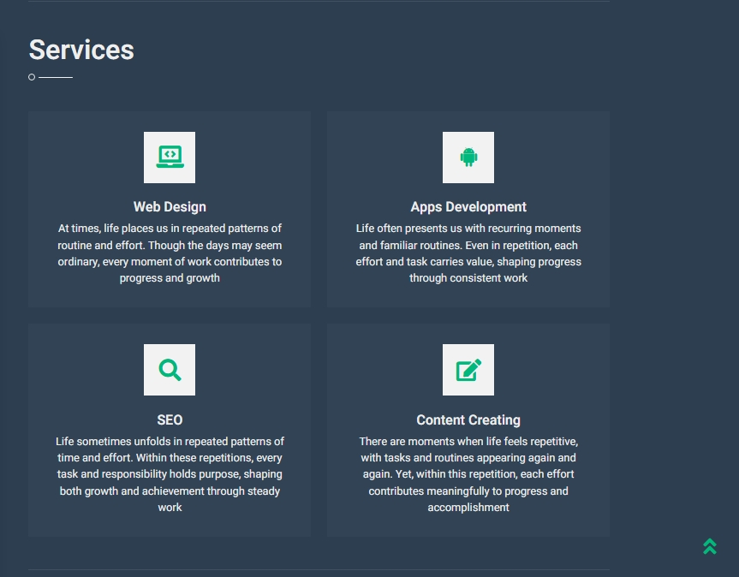

Slide 14
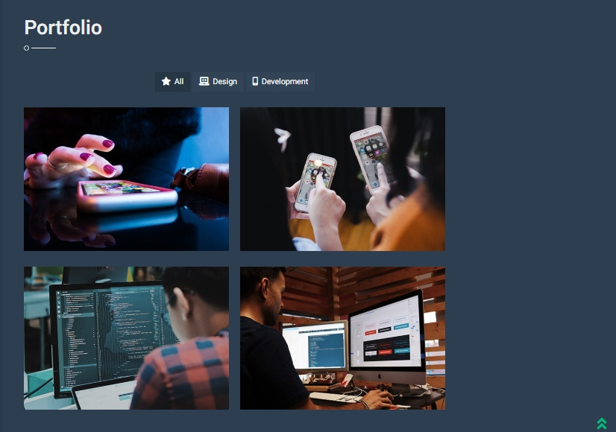

Slide 15
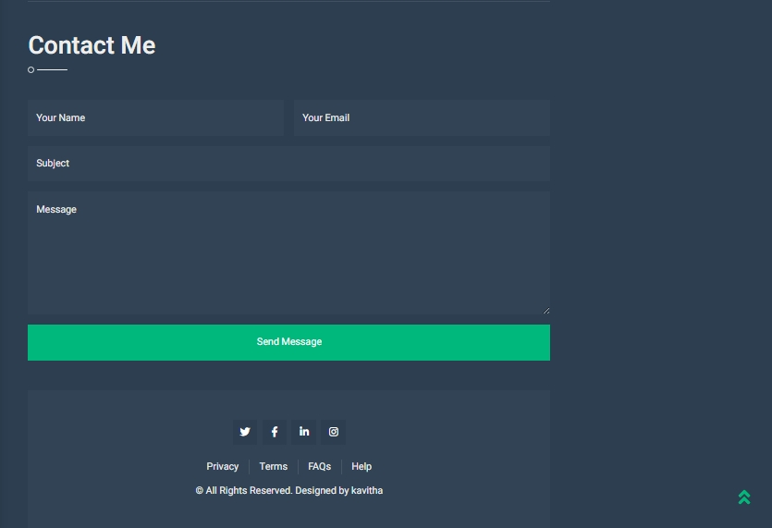

Slide 16

https://kavitha-source-ui.github.io/Kavitha_portfolio/

Slide 17
CONCLUSION
The portfolio makes it easy to present my skills and projects to potential
‹#›

